Slide 1

CPSC 3750 – Artificial Intelligence
Breaking Down Sentences into Parts of Speech
By: Tarun, Michael, and Devjot

Slide 2
Introduction
For our project, we’ve created a program written in C++ that breaks down sentences into parts of speech using Constraint Satisfaction Problem (CSP) technique.
We’ve used libraries and tools such as pybind11, NLTK, and CMAKE
Along with CSP, we’ve also utilized the Backtracking Algorithm in our program, similar to our second assignment.
Notes:
Our project is on breaking sentences into parts of speech mainly using CSP, among other things such as libraries like pybind11, NLTK packages
We also use the Backtracking Algorithm as well

Slide 3
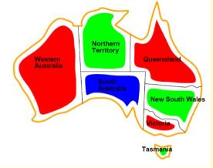
Constraint Satisfaction Problem (CSP)
What is CSP exactly? In layman’s terms, it is a problem that requires a solution to be within limitations and specific conditions set
This means there are a finite variable, a domain variable, and a finite constraint set
The variables are the words in a sentence
The domains are the possible parts of speech for each word
While the constraints are grammatical rules

Slide 4
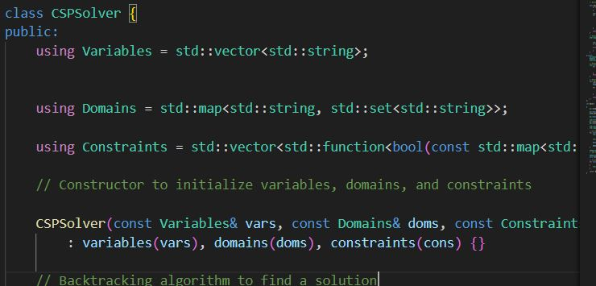
Constraint Satisfaction Problem (CSP)
Code Snippet
Notes:
As you can see in the code, inside a class called CSPSolver we have vectors stored for variables, domains, and constraints

Slide 5
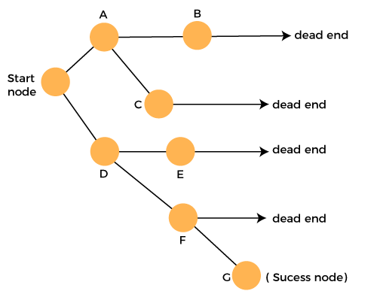
Backtracking Algorithm
We’ve also used the Backtracking Algorithm we learned in the lecture as well. Which is a method for essentially generating all possible solutions to a CSP by incrementing potential candidates for a solution
But a candidate is invalid after it fails to be a complete solution that is valid and sound.

Slide 6
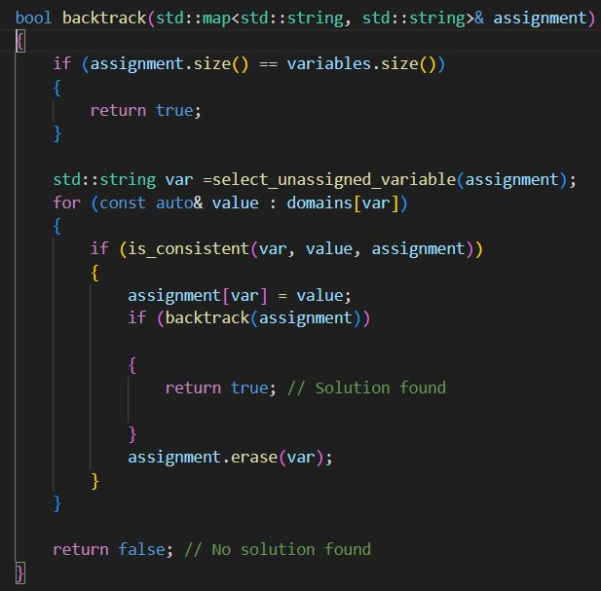
Backtracking Algorithm
Code Snippet
Notes:
We have a function Boolean function called backtrack where it has conditional statements for the size of the assignment itself, and the variables
Explain how backtracking works which is what the for-loop is

Slide 7

Libraries
Pybind11 is used so that we don’t have to hardcode some of the fundamentals. This Python library is used to create C++ bindings and integrate it with our C++ source code.
This is where the Natural Language Toolkit (NLTK) is also used for linguistics of sentences being inputted.
Notes:
We also used pybind11 which is a python library to avoid hardcoding some things
And after some research we found out that NLTK has packages that many use in AI linguistics development

Slide 8
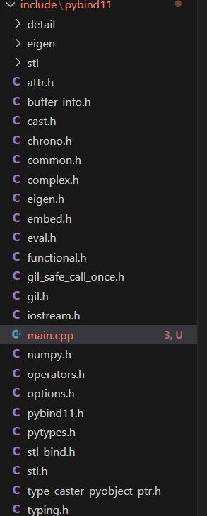
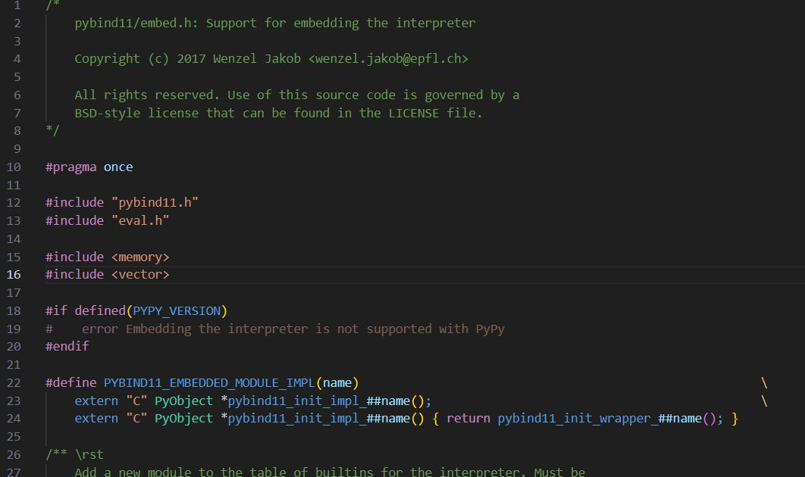
Pybind11 and NLTK
Code Snippet
Notes:
As you can see these are some of the hard-coded libraries on the left however we did not need to use all.

Slide 9
Execution – How Does It Work?
The sentence is tokenized into individual words/terms.
Our pos_tag function is used to give tags to each word in that very sentence
Afterwards, variables are created for each word, and their domains have those tags stored in them
The grammatical constraints are defined and added to our CSPSolver class
Finally when the CSPSolver function is invoked to get a solution. And the solution itself contains a mapping of the words based on their tags
For example “Tarun” = noun. (Constraints)
Notes:
Basically a sentence is inputted, or in this case hardcoded for the sake of an example, then each word has given tags thanks to our pos_tag function in “py” inside our int main
Then variables are created to store those tags including their domains
Constraints are defined and applied in our class CSPSolver which then gets a solution and maps out each word using the tags by defining each word. For example “Michael”, “Tarun”, “Devjot” are names, and names are noun, which are the constraints and the grammatical rules implemented. So the output would be Tarun = noun, etc.

Slide 10

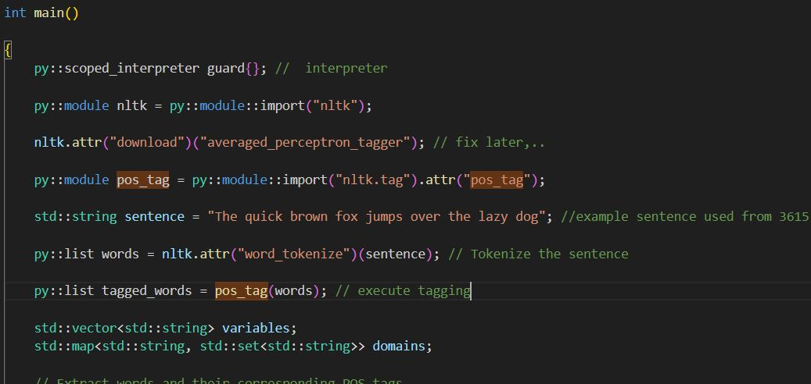
Main.cpp
Code Snippet
Notes:
This part of our int main highlighting the pos_tag that applies tags to each word which then variables are created to store them
Then of course there is a string sentence example used from 3615 that is hard-coded for an example.
Afterwards the output is a list “(list tagged_words)” which would use the tags of “noun”, “verb”, etc. for each word in the sentence

Slide 11
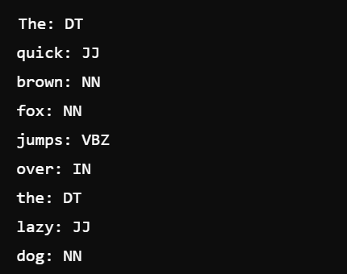
Main.cpp
Example Output
Notes:
So this is the sample output for the sentence in our code we used for an example, as you can see each word has a tag that is being called using variables that were created, and those tags represent the constraints, or the grammatical rules of noun, verb, etc.
Run the program to show to the class

Slide 12
References
NLTK. (n.d.). https://www.nltk.org/
Constraint satisfaction problem in ai. AlmaBetter. (n.d.). https://www.almabetter.com/bytes/tutorials/artificial-intelligence/constraint-satisfaction-problem-in-ai
GeeksforGeeks. (2024, June 6). Constraint satisfaction problems (CSP) in Artificial Intelligence. https://www.geeksforgeeks.org/constraint-satisfaction-problems-csp-in-artificial-intelligence/
Pybind. (n.d.). Pybind/pybind11: Seamless operability between C++11 and python. GitHub. https://github.com/pybind/pybind11.git
Lecture Slides
Russell, S., & Norwig, P. (2013). Artificial Intelligence: A modern approach (4th ed.). Pearson Education Limited.

